Slide 1
Virtual private network (VPN)

Slide 2
What is Virtual Private Network (VPN)
A Virtual Private Network is a type of private network that you uses public telecommunication, such as the Internet, instead of leased line to communicate.
A Virtual Private Network (VPN) is a technology that creates a safe and encrypted connection over a less secure network.
VPN hides the remote server IP address behind its own IP address that encrypts all your communication. Thus, the communication passes through a secure tunnel that allows you use network resources freely and secretly.

Slide 3
Features of Virtual Private Network (VPN)
Confidentiality: preventing anyone from reading your data. This is implemented with encryption.
Authentication: verifying that the router/firewall or remote user that is sending VPN traffic is a legitimate device or router.
Integrity: verifying that the VPN packet wasn’t changed somehow during transit.

Slide 4
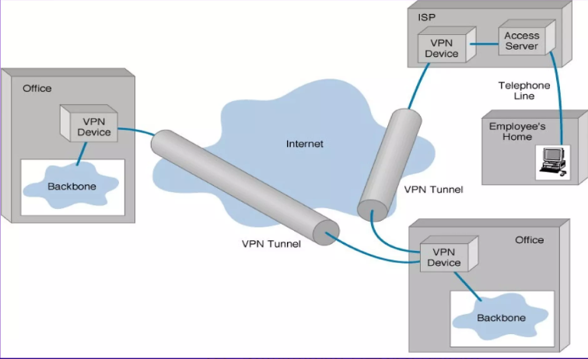
Basic Architecture of VPN

Slide 5
Types of Virtual Private Network (VPN)
There are two types of VPN :-
Site-to-site VPN - With the site-to-site VPN, we have a network device at each site, between these two network devices we build a VPN tunnel. Each end of the VPN tunnel will encrypt the original IP packet, adds a VPN header, a new IP header and then forwards the encrypted packet to the other end of the tunnel.
Client-to-site VPN - The client-to-site VPN is also called the remote user VPN. The user installs a VPN client on his/her computer, laptop, smartphone or tablet. The VPN tunnel is established between the user’s device and the remote network device.

Slide 6
Advantages and Disadvantages of VPN
Advantages
VPN secures the data breach.
It protects the online privacy
VPN masks the IP address of the user.
It prevents from Bandwidth Throttling based on certain activities.
VPN also protects from DDoS attack
Disadvantages
VPN slows down the internet speed.
Some cheap and free VPN in market are insecure and can collect your data.
VPN cannot protect from Data hoarding on social media.

Slide 7
Graphical user interface
(gui)

Slide 8
What is Graphical User Interface (GUI)
Graphical User Interface (GUI) is a visual interacting with the computer using the component like windows, icon, labels, text-boxes, radio buttons etc.
GUI is a program interface that takes the advantage of the computer graphics capabilities to make the program easier to use.
GUI uses windows, icons and menus to carry out commands such as opening files, deleting files and moving files.
It refers to the graphical interface of a computer that allows users to click and drag object with a mouse instead of entering text at a command line.

Slide 9
Features of graphical user interface (GUI)
Much easier to use for beginners
Enable an easy exchange of information between software using cut and paste, or 'drag and drop’
Use a lot of memory and processing power (can be slower than command line interfaces operated by expert users)
Can be irritating to experienced users when simple tasks require a number of operations

Slide 10
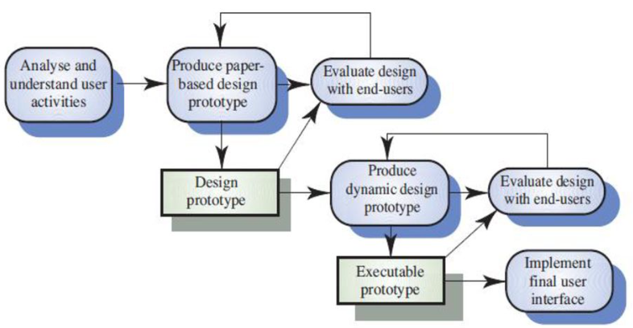
User Interface Design Process

Slide 11
GUI Elements
Input Controls :- Buttons, Checkboxes, Date picker, Dropdown lists, List Boxes, Text Boxes, Toggles.
Navigational Component :- Breadcrumbs, Icons, Image carousel, Pagination, Search fields, sliders, tags, tabs.
Informational Component :- Message box, Notifications, Pop-up windows, Progress bar, Tool tips.

Slide 12
Benefits Of Graphical User Interface (GUI)
Easy to Use :- Since data is represented by symbols, shapes and icons, users can easily recognize, classify and navigate options. A simple click is all it takes to acquire a function.
Easy to Communicate :- Visual representation of data is recognized faster than text. Non-programmers find it easy to use GUIs since it requires no experience with computing commands.
Attractive :- GUI has visually appealing features and is not cluttered with command line codes.
Provides shortcuts :- GUI lets users take advantage of shortcut keys to minimize strokes. A combination of two keys in place of several actions saves the user time and increases productivity.

Slide 13
THANK YOU

